Slide 1

Value-Quality-Momentum Strategy
George Moschovis & Florent Yigbe
G_5 Gamma Gurus
Hedge Fund Club - Universität Mannheim & Prime Capital

Slide 2
SUMMARY
Core Idea
Signal Design (Alpha)
Risk Management
Universe & Data
Portfolio
Construction
Backtesting & Performance

Slide 3
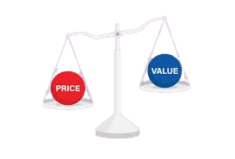


CORE IDEA
What’s the core investment hypothesis ?
Identify undervalued stocks with strong fundamentals and positive momentum outperform over 1–3 years
Why does this opportunity exist ?
Investors often overlook high-quality undervalued companies, creating mispricing opportunities
Asset universe
Top 300 S&P 500 companies

Slide 4
UNIVERSE & DATA
Universe
Data (from yfinance)
Daily/weekly prices
Fundamentals: P/E, P/B, EV/EBITDA, ROE, Debt/Equity
Frequency
Quarterly fundamentals, daily prices
S&P 500
Market cap > $5B
Average daily volume > 500k

Slide 5

SIGNAL DISIGN (Alpha)
Value factors: Low P/E, low EV/EBITDA, low P/B
Quality factors: High ROE, low debt/equity
Momentum filter: Only select stocks with positive 3 and 12-month price momentum.

Slide 6
PORTOFOLIO CONSTRUCTION
Long top 20 ranked stocks.
5% to each position
Equal weight
Rebalance semi-annually and when a stock is no more part of the S&P 500 we replace it according to our strategy .
Notes:
Quatity of data is to high ?
What to do when a stock is performing to well ?

Slide 7
RISK MANAGEMENT
Stop-loss: deterioration in fundamentals.
Max 30% exposure per sector.
Track: max drawdown, Sharpe ratio, beta vs S&P 500

Slide 8
BACKTESTING & PERFORMANCE
Period: Last 20 years
Benchmark: S&P 500
Metrics: Annualized return, Annualized Volatility, Sharpe ratio, Max Drawdown, Var, CVar
Stress test during market crises (2008, 2020).

Slide 9
Potential Risks

Slide 10
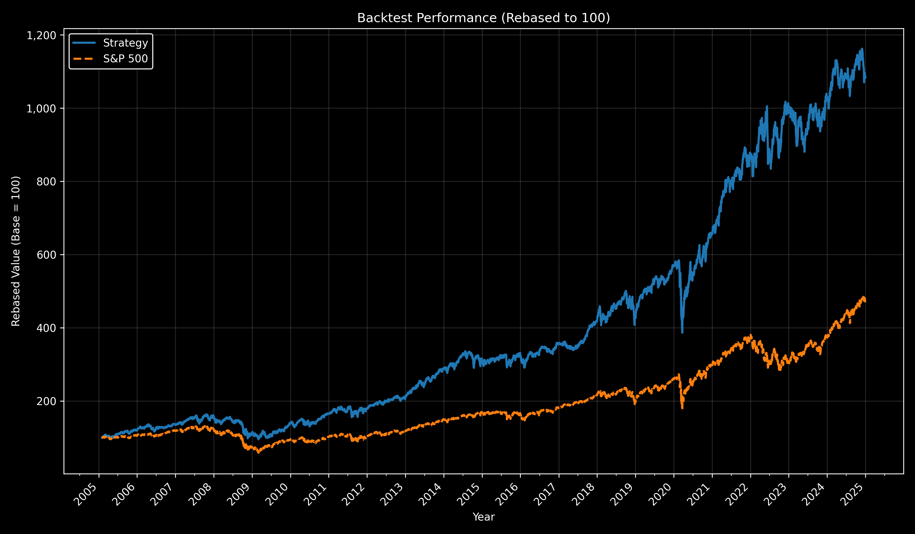

Slide 11
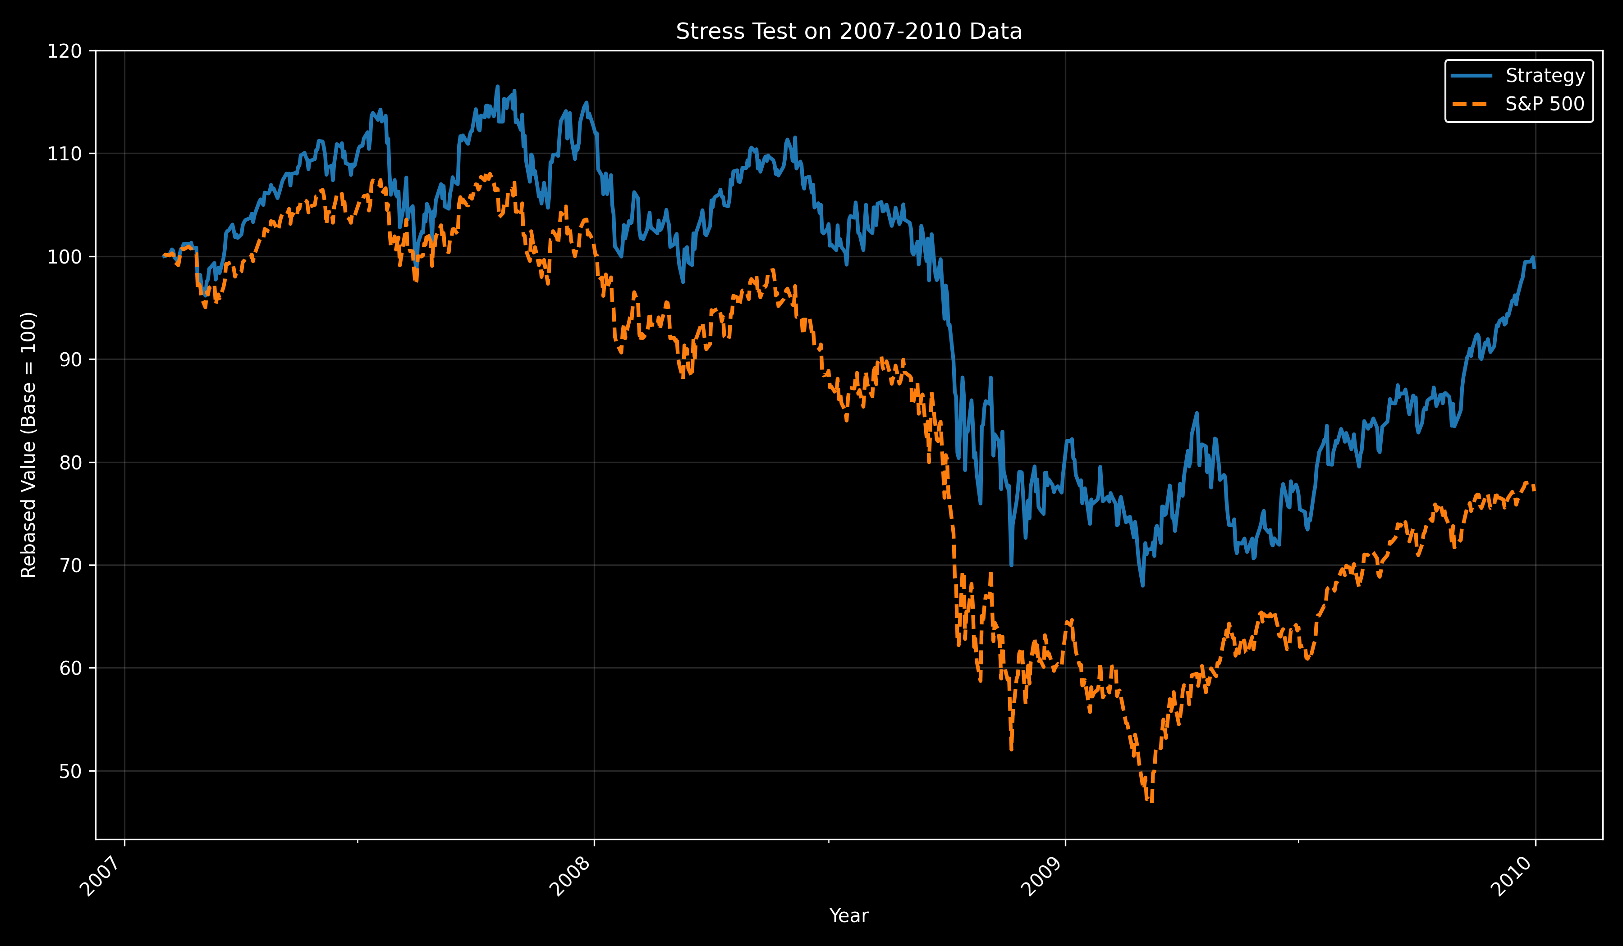

Slide 12
